Slide 1
Analysis of rate of H1B Visa Issuance of International Employees in the United States-2021-Q1
IE6200 Engineering Probability & Statistics - Final Project

Slide 2
Introduction:-
All of the non-immigrant workers in the US have a very significant role played by the H1b visa in their lives. In this project, we'll be looking at the trends in the issue of this visa in relation to several key variables. As a result, we assembled the dataset of applicants who received their H1b decision in the first quarter of 2021, and we attempted to analyze what it was attempting to say using a number of statistical criteria.
Notes:
AS WE ALL KNOW H1B VISA IS VERY CRUCIAL IN EVERYONE’S LIFE , SO WE KNOW THAT H1B IS BASED ON A LOTTERY SYSTEM HOWEVER THERE MAY BE SOME PARAMETERS ON WHICH IT MAY IMPACT THE VISA ISSUANCE RATE.WE HAVE ATTEMPTED TO ANALYZE THEM USING SOME STATISTICAL METHODS.

Slide 3
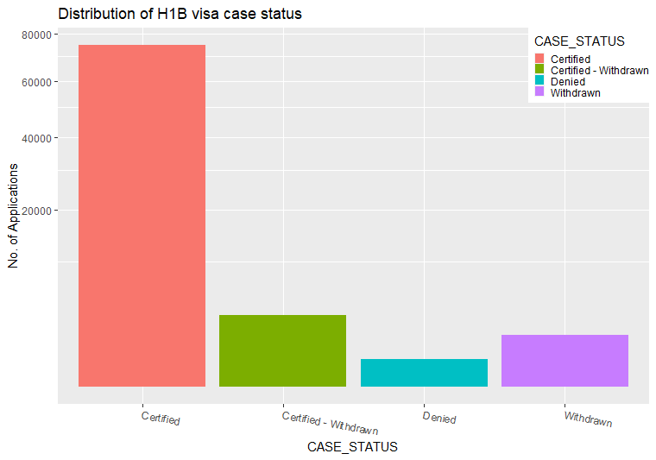
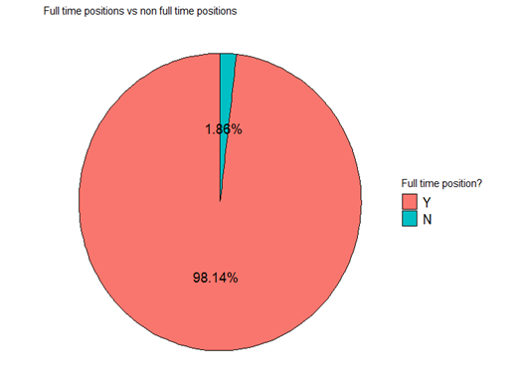
Analysis of H1b’s Visa status
The average H1b visa status and predicted visa status are being compared. The Bar-Graph below represents the case status and Number of visa Applications applied.
Notes:
HERE THERE ARE NUMBER OF THINGS WHICH ARE PRESENT IN CASE STATUS MAINLY
CERTIFIED - APPROVED
CERTIFIED WITHDRAWN - PEOPLE WHO ARE CERTIFIED BUT HAVE WITHDRAWN
DENIED - PEOPLE WHO HAVE GOT THEIR VISA DENIED
WITHDRAWN - PEOPLE WHO HAVE WITHDRAWN FROM THE VISA STATUS
HERE WE ARE PLOTTING A GRAPH BETWEEN CASE STATUS AND NO OF APPLICATIONS AND WE CAN SEE APPLICANTS GETTING THEIR VISA APPROVED IS MORE AND DENIED BEING THE LEAST.

Slide 4
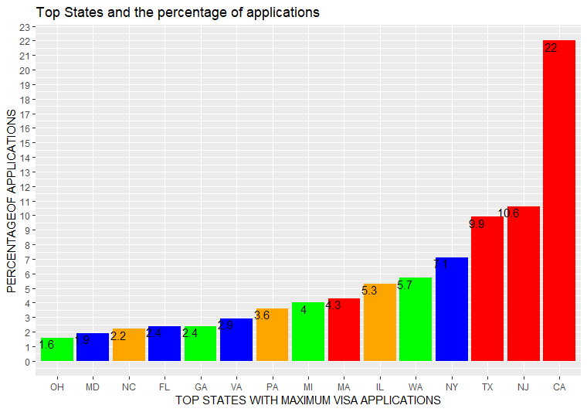
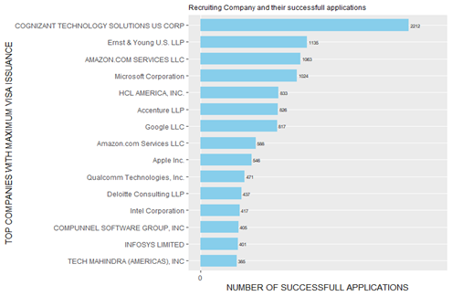
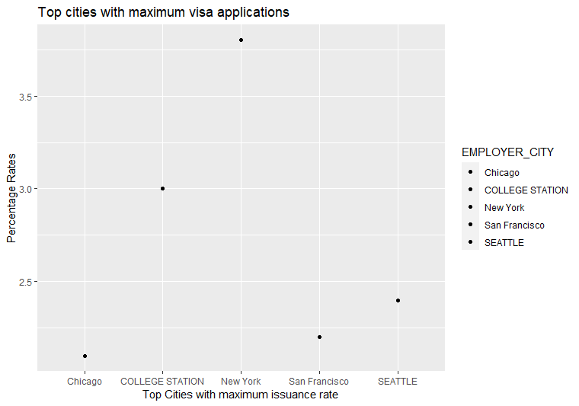
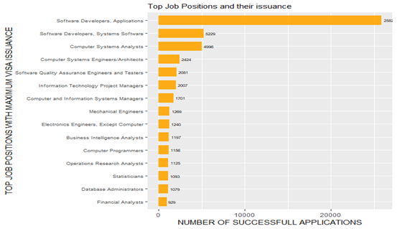
Comparing Top 15 Companies, States , Cities & Job position
Notes:
ALSO WE HAVE PLOTTED SOME GRAPHS REGARDING TOP STATES , TOP CITIES AND TOP COMPANIES REGARDING THEIR VISA ISSUANCE RATE.
CALIFORNIA HAS THE HIGHEST VISA ISSUANCE RATE COMPARED TO ANY OTHER STATE.
COGNIZANT IS THE HIGHEST RECRUITING COMPANY WHICH HELPS IN ISSUANCE OF A H1B VISA.
NEW YORK CITY HAS THE HIGHEST PERCENTAGE OF VISA APPROVAL RATE COMPARED TO OTHER CITY.

Slide 5
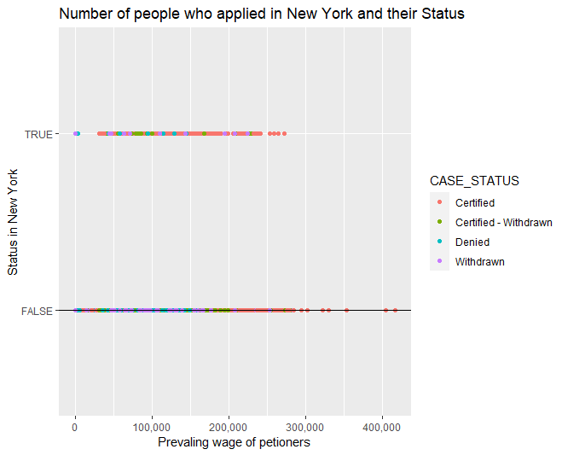
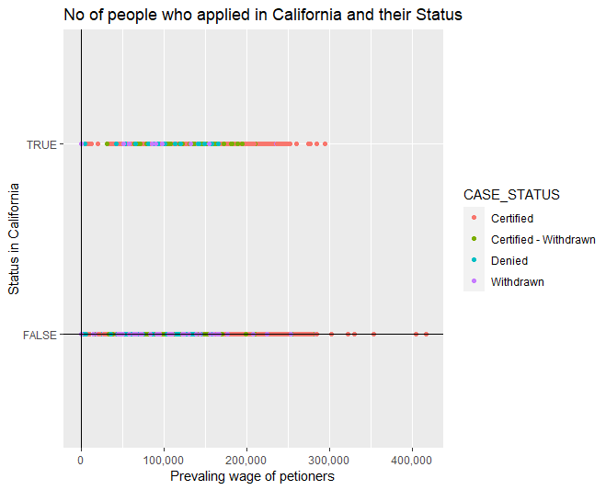
Scatter Plot
A representation of the relationship between two variables is called a scatter plot.These two graphs explain about the various prevailing wages in various states in US.
Notes:
WE CAN SEE THAT THESE GRAPHS TALKS ABOUT THE NUMBER OF PEOPLE WHO HAVE APPLIED AND THEIR CURRENT STATUS.
WE HAVE TAKEN ONLY NEW YORK AND CALIFORNIA BECAUSE THEY HAVE THE HIGHEST APPROVAL RATE.
The true value from the scatter plot states the case status of petitioners only from NEW YORK and the false values shows the case status of the other states.

Slide 6
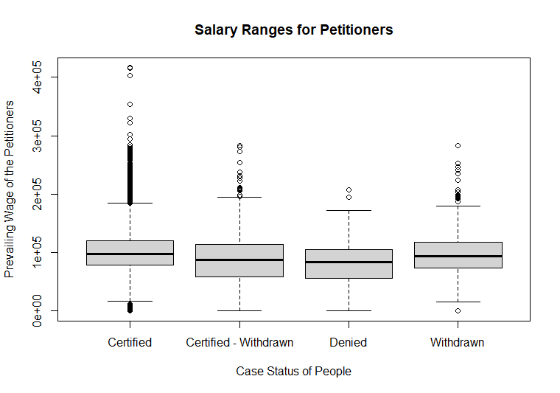
Boxplot of Salary
The prevailing pay and the state of people's cases are shown in this box graph. As we can see, there are some differences in the median incomes across all classifications, leading us to the conclusion that there are many other considerations that are more important in determining whether or not you will be granted an H1B visa.

Slide 7
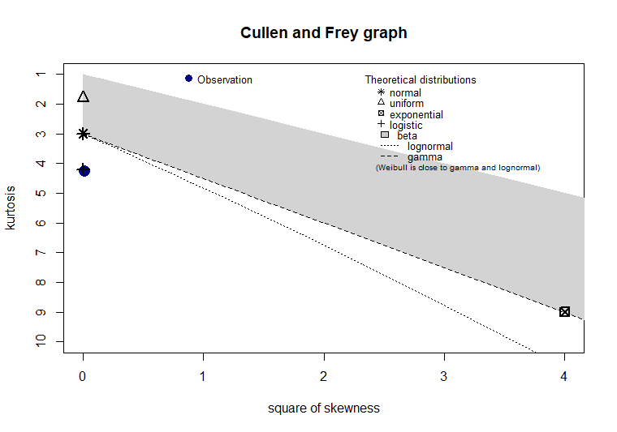
Goodness of Fit test for Distribution of Salaries
The data set's observations are plotted against several distributions in the Cullen and Frey graph. we were able to state that the distribution is close to Log normal Distribution, Normal Distribution and Logistic Distribution.

Slide 8
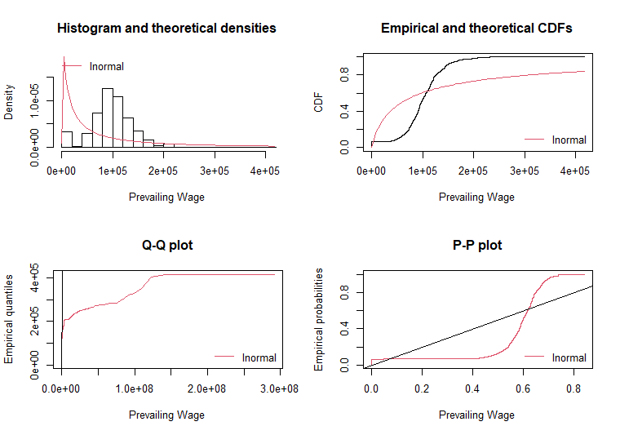
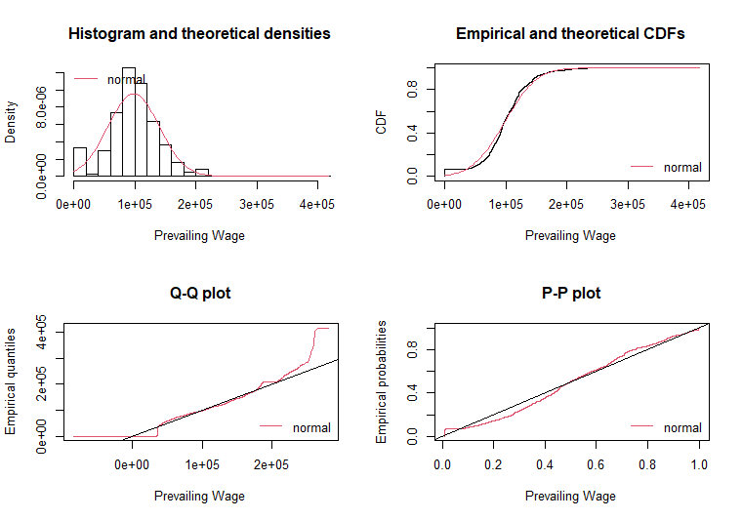
Goodness of Fit
Lognormal Vs Normal

Slide 9
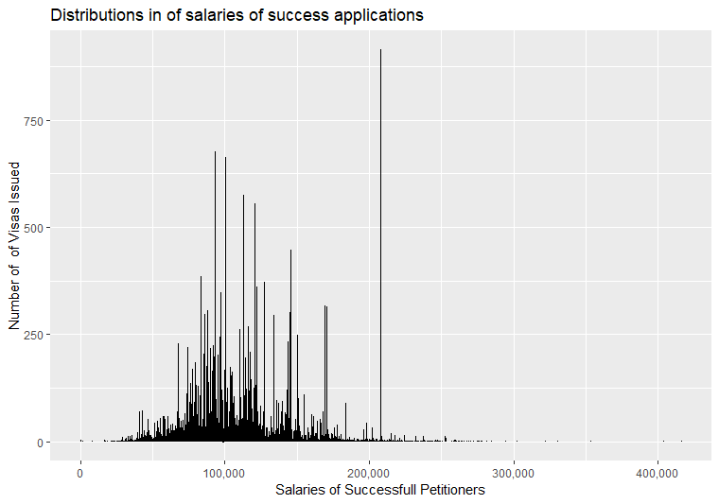
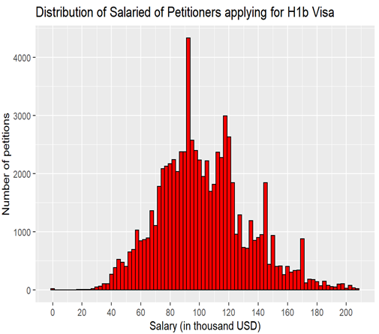
Distribution of Salaries of Applicants

Slide 10
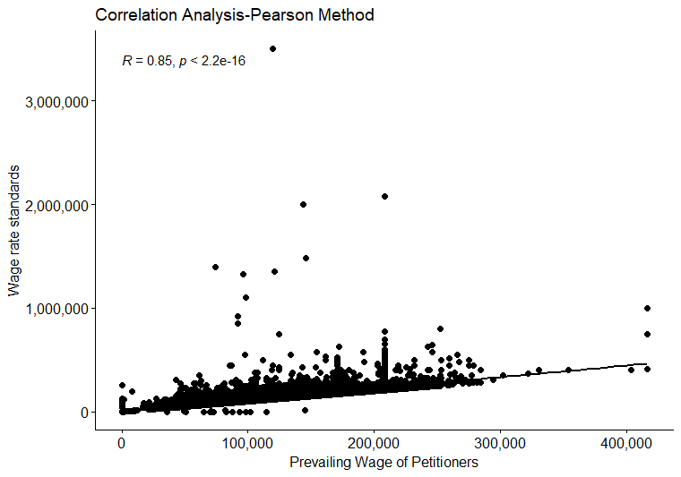
Correlation Analysis
Establishing the presence of a relation between variables, as well as its strength and course of action. Pearson’s method measures a linear relationship between two variables.

Slide 11

Hypothesis to compare proportion of visas getting issued in 2021 versus 2016.
87.9%
Null Hypothesis, H0: - Pop_prop = 87.9% (There is no significant difference between proportion of applicants getting H1B visa in 2016 and proportion of applicants getting h1b visa in 2021)
Alternative hypothesis, H1: - Pop_prop! = 87.9% (There is a significant difference between proportion of applicants getting H1B visa in 2016 and proportion of applicants getting h1b visa in 2021)
As p-value<0.05 →We reject the null hypothesis
93.18%

Slide 12

Hypothesis to check whether the proportion of salary of international employees working in California & Texas are equal.
Mean: $119056
Mean: $89674
Null Hypothesis, H0: sal_cali-sal_tx = 0 (There is no significant difference between proportion of salary of international employees working in California and proportion of international employees working in Texas).
Alternative Hypothesis, H1: sal_cali-sal_tx != 0 (There is a significant difference between proportion of salary of international employees working in California and proportion of international employees working in Texas).
As p-value < 0.05, we reject the null hypothesis

Slide 13

Conclusion
At the end of our analysis, we found out that none of the parameters influence the results.
From the Salary analysis, we can see that people who got their visa certified and denied is more similar.
Even though states like California and Cities like New York has issuance rate and Companies like Cognizant and Job position like Software Developer, Applications, it doesn’t guarantee that if you follow this pattern, you will end up getting a visa.
Notes:
TITLE
CERTIFIED PROBABILITY
DENIED PROBABILITY
California Petitioners
93.83%
0.47%
New York City Petitioners
92.20%
1.001%
Software Developers, Application-Petitioners
94.44%
0.44%
Cognizant Technology-Petitioners
91.9%
0
Full Time Position
93.18%
0.59%

Slide 14


